Slide 1



Automated Reasoning about Software ($67532$)
Guy Katz
Lecture 9: Theory Combination December $23$^{rd} , $2019$

Slide 2
Acknowledgements
Some of the material presented has been borrowed from slides by David Dill, Isil Dillig, Gera Weiss, Clark Barrett, Alex Aiken, Mooly Sagiv, Sagar Chaki and Ofer Strichman

Slide 3
Recap
SMT solvers: general purpose reasoning engines
Their language: first order logic (FOL)
DPLL(T): a modular framework for combining SAT solvers and theory solvers
Separate theories have separate solvers, and these sometimes need to be combined

Slide 4
SMT: Main Challenges
How to solve conjunctions of literals in a theory?
Use theory solvers
How to combine solvers for multiple theories
The Nelson-Oppen method
How to combine a theory solver and a SAT solver
The DPLL(T) framework

Slide 5
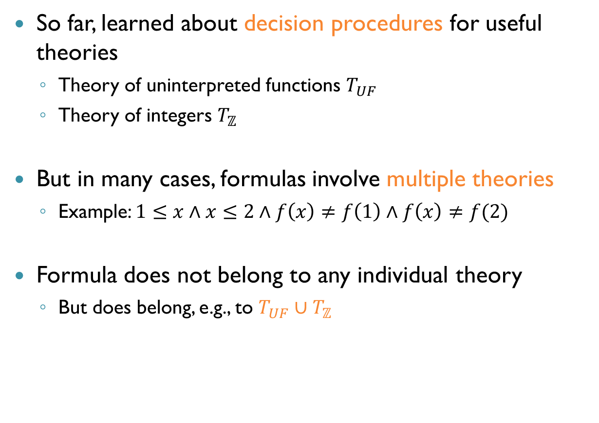
Formulas That Combine Theories
So far, learned about decision procedures for useful theories
Theory of uninterpreted functions $T_{UF}$
Theory of integers $T_{ℤ}$
But in many cases, formulas involve multiple theories
Example: $1≤x∧x≤2∧f\left(x\right)≠f\left(1\right)∧f\left(x\right)≠f(2)$
Formula does not belong to any individual theory
But does belong, e.g., to $T_{UF}∪T_{ℤ}$

Slide 6
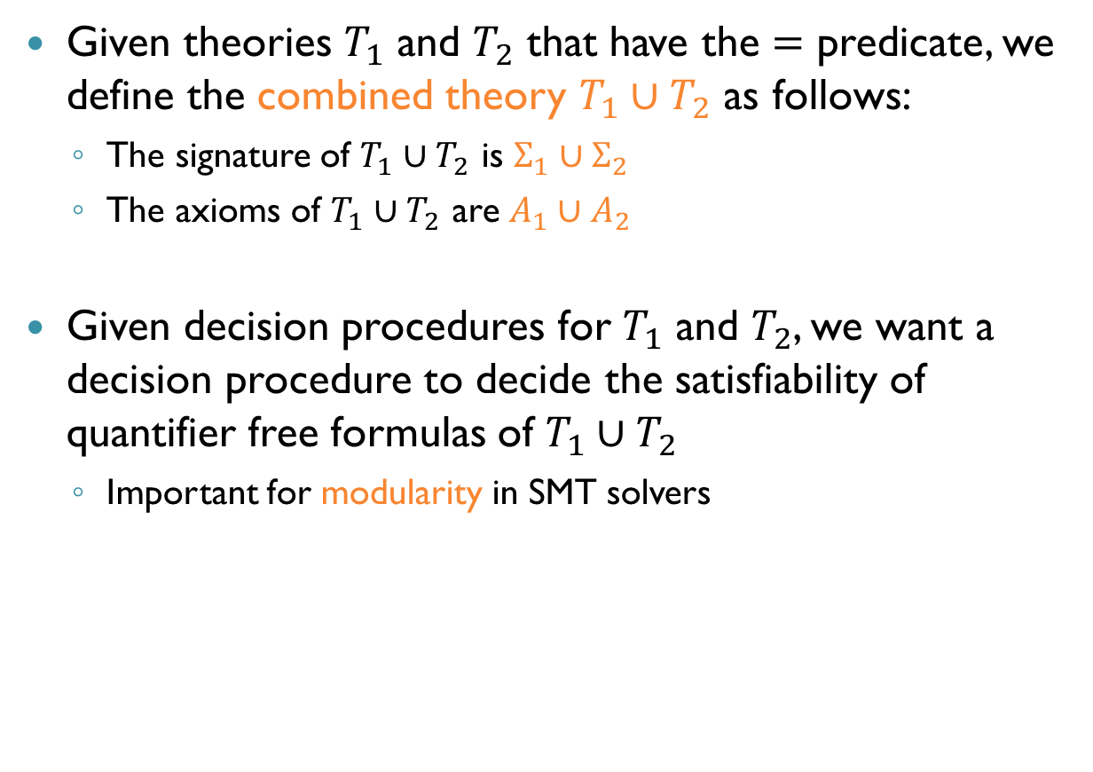
Combined Theories
Given theories $T_{1}$ and $T_{2}$ that have the $=$ predicate, we define the combined theory $T_{1}∪T_{2}$ as follows:
The signature of $T_{1}∪T_{2}$ is $Σ_{1}∪Σ_{2}$
The axioms of $T_{1}∪T_{2}$ are $A_{1}∪A_{2}$
Given decision procedures for $T_{1}$ and $T_{2}$, we want a decision procedure to decide the satisfiability of quantifier free formulas of $T_{1}∪T_{2}$
Important for modularity in SMT solvers

Slide 7




Nelson-Oppen Overview
A method for combining theory solvers
Can combine an arbitrary number of theories
E.g., combine $T_{1}$ and $T_{2}$, then combine $(T_{1}∪T_{2})$ with $T_{3}$
Theory $T_{1}$, decision procedure $P_{1}$
Theory $T_{2}$, decision procedure $P_{2}$
Nelson-Oppen
Theory $T_{1}∪T_{2}$, decision procedure $P$

Slide 8
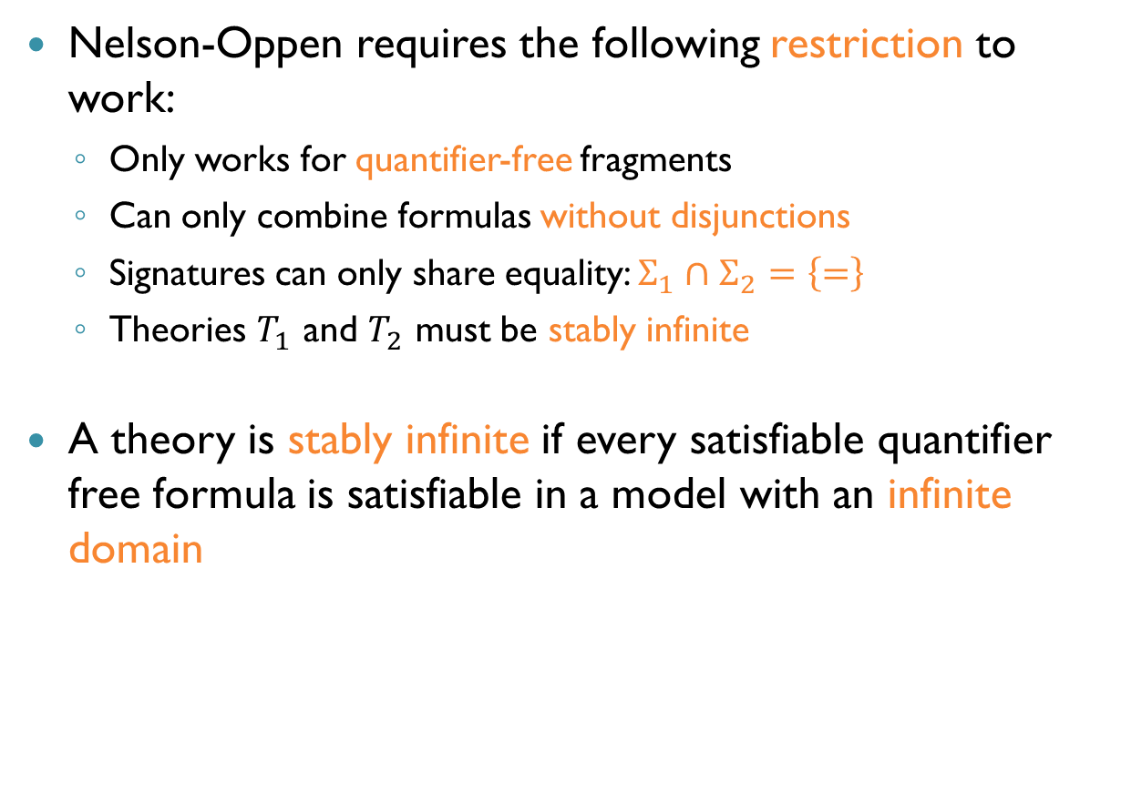
Nelson-Oppen: Restrictions
Nelson-Oppen requires the following restriction to work:
Only works for quantifier-free fragments
Can only combine formulas without disjunctions
Signatures can only share equality: $Σ_{1}∩Σ_{2}=\left\{=\right\}$
Theories $T_{1}$ and $T_{2}$ must be stably infinite
A theory is stably infinite if every satisfiable quantifier free formula is satisfiable in a model with an infinite domain

Slide 9
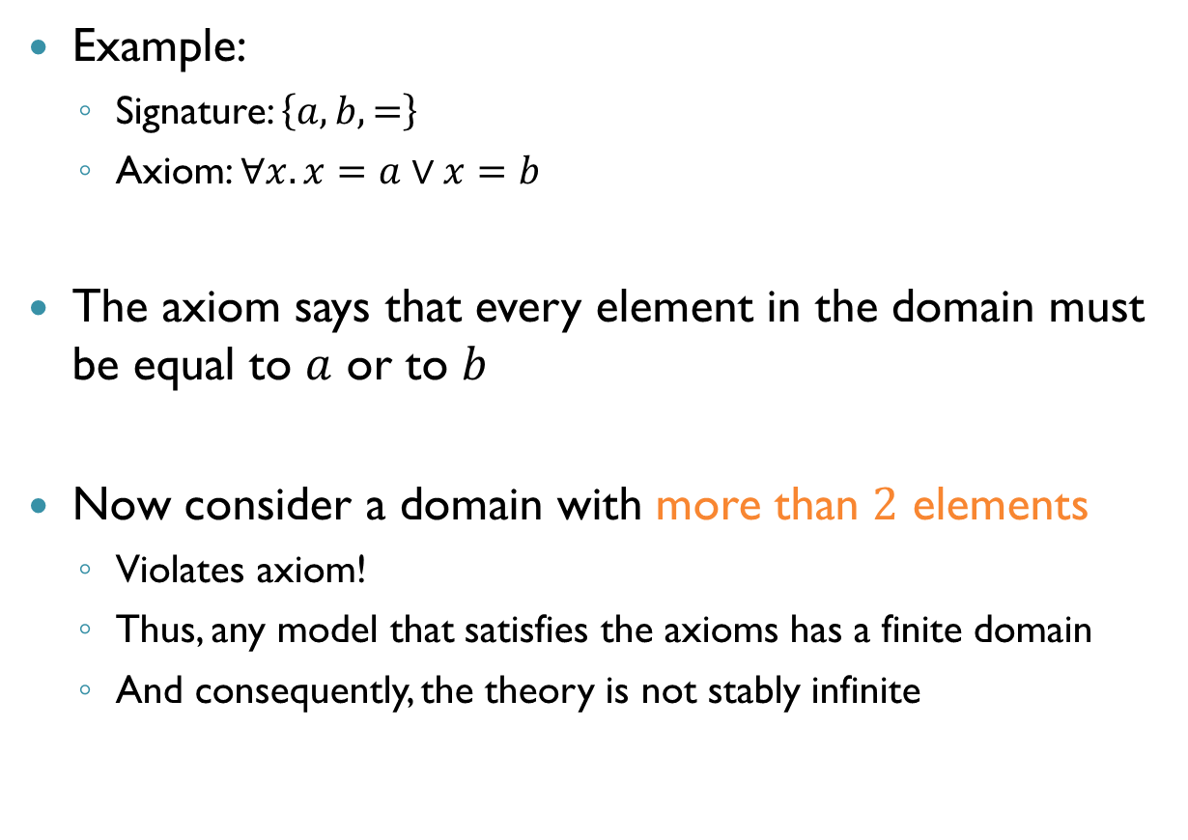
A Non-Stably Infinite Theory
Example:
Signature: $\left\{a,b,=\right\}$
Axiom: $∀x. x=a∨x=b$
The axiom says that every element in the domain must be equal to $a$ or to $b$
Now consider a domain with more than $2$ elements
Violates axiom!
Thus, any model that satisfies the axioms has a finite domain
And consequently, the theory is not stably infinite

Slide 10
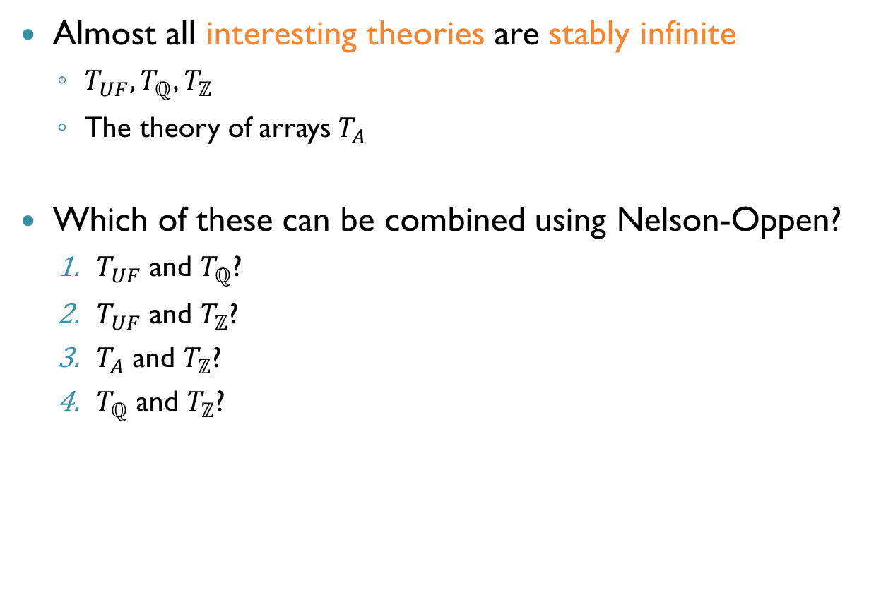
Stably Infinite Theories
Almost all interesting theories are stably infinite
$T_{UF}, T_{ℚ}$, $T_{ℤ}$
The theory of arrays $T_{A}$
Which of these can be combined using Nelson-Oppen?
$T_{UF}$ and $T_{ℚ}$?
$T_{UF}$ and $T_{ℤ}$?
$T_{A}$ and $T_{ℤ}$?
$T_{ℚ}$ and $T_{ℤ}$?
Yes
Yes
Yes
No

Slide 11
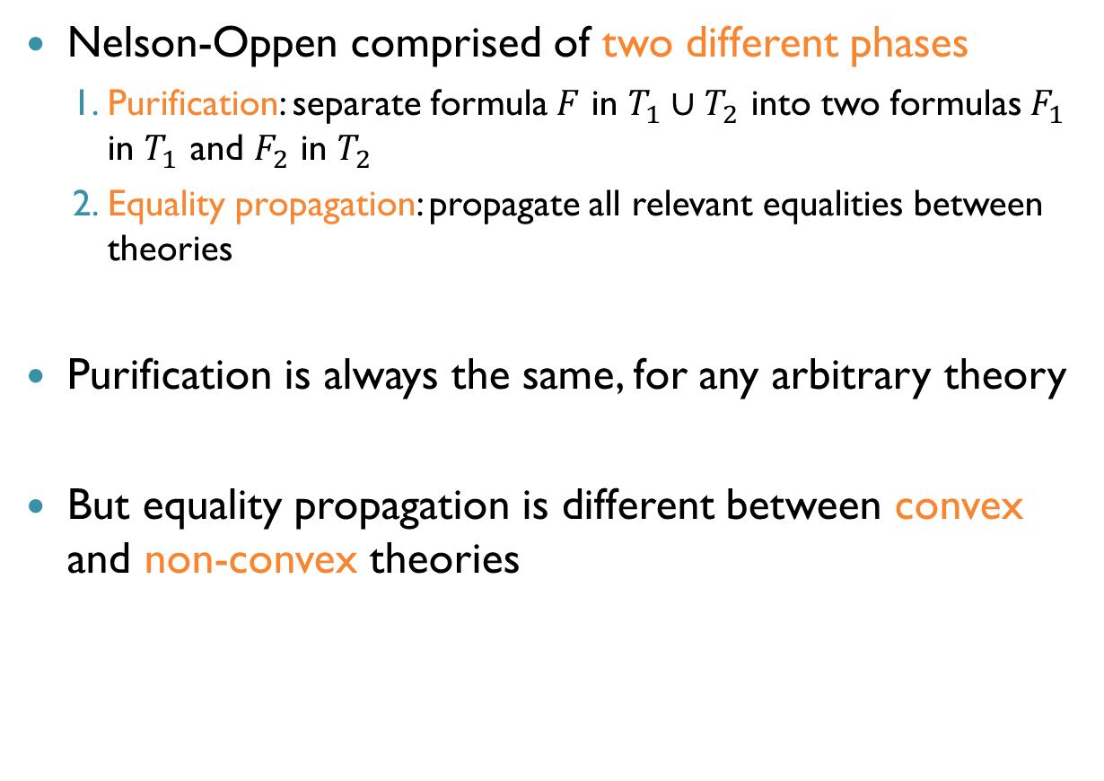
Nelson-Oppen Overview
Nelson-Oppen comprised of two different phases
Purification: separate formula $F$ in $T_{1}∪T_{2}$ into two formulas $F_{1}$ in $T_{1}$ and $F_{2}$ in $T_{2}$
Equality propagation: propagate all relevant equalities between theories
Purification is always the same, for any arbitrary theory
But equality propagation is different between convex and non-convex theories

Slide 12
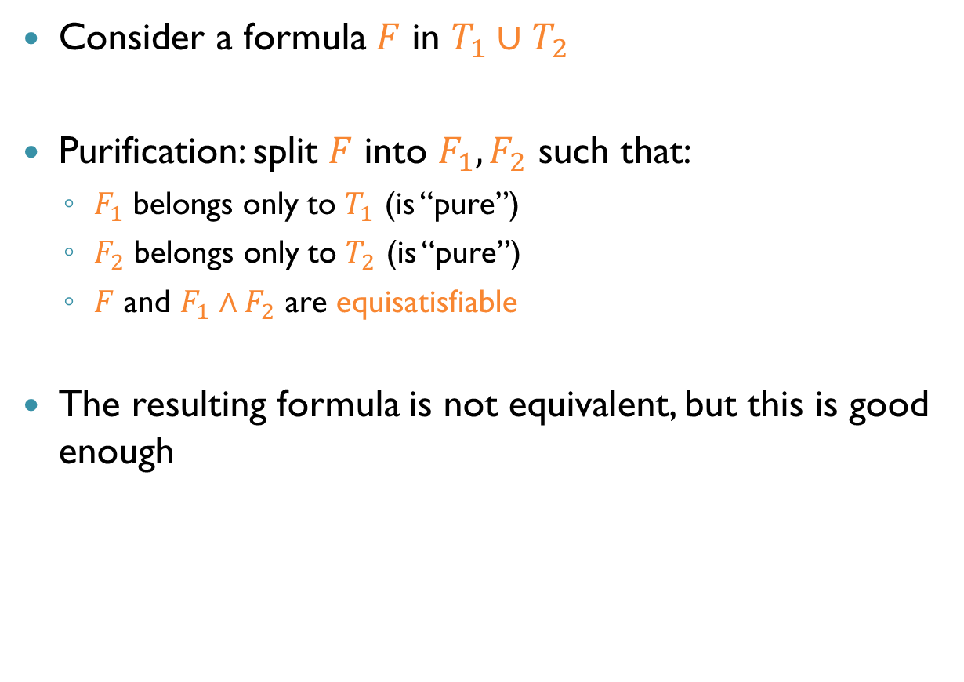
Purification
Consider a formula $F$ in $T_{1}∪T_{2}$
Purification: split $F$ into $F_{1},F_{2}$ such that:
$F_{1}$ belongs only to $T_{1}$ (is “pure”)
$F_{2}$ belongs only to $T_{2}$ (is “pure”)
$F$ and $F_{1}∧F_{2}$ are equisatisfiable
The resulting formula is not equivalent, but this is good enough

Slide 13
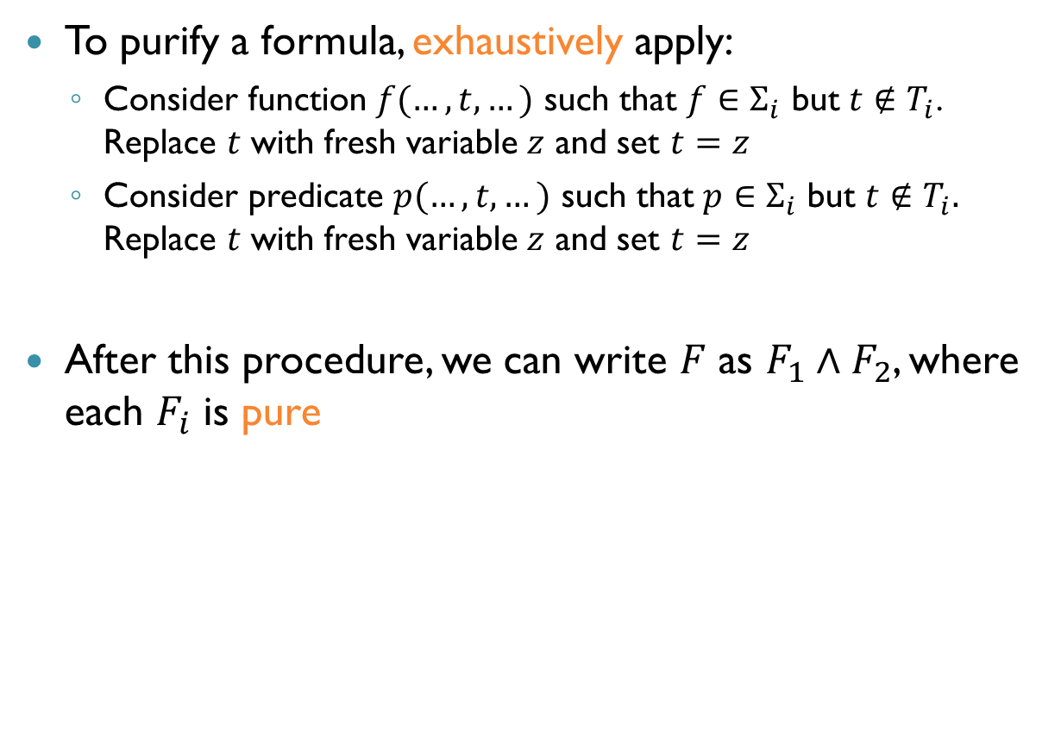
How to Purify
To purify a formula, exhaustively apply:
Consider function $f(…,t,…)$ such that $f∈Σ_{i}$ but $t∉T_{i}$. Replace $t$ with fresh variable $z$ and set $t=z$
Consider predicate $p(…,t,…)$ such that $p∈Σ_{i}$ but $t∉T_{i}.$ Replace $t$ with fresh variable $z$ and set $t=z$
After this procedure, we can write $F$ as $F_{1}∧F_{2}$, where each $F_{i}$ is pure

Slide 14




Purificaiton: Example $1$
Consider $T_{UF}∪T_{ℚ}$ formula $x≤f\left(x\right)+1$
Is this formula already pure?
$f(x)$ not in $T_{ℚ}$, replace with $y$ and set $f\left(x\right)=y$
Result: $x≤y+1∧y=f(x)$
$$T_{ℚ}$$
$$T_{UF}$$

Slide 15


Purificaiton: Example $2$
Consider $T_{UF}∪T_{ℤ}$ formula $f\left(x+g\left(y\right)\right)≤g\left(a\right)+f\left(b\right)$
Purify “inside out”
Is $x+g(y)$ pure?
After purification: $f\left(x+z_{1}\right)≤g\left(a\right)+f\left(b\right)∧z_{1}=g(y)$

Slide 16

Purificaiton: Example $2$
Formula:
$$f\left(x+z_{1}\right)≤g\left(a\right)+f\left(b\right)∧z_{1}=g(y)$$
Is $f(x+z_{1})$ pure?
Resulting formula:
$$f\left(z_{2}\right)≤g\left(a\right)+f\left(b\right)∧z_{1}=g\left(y\right)∧z_{2}=x+z_{1}$$
Is the formula now pure?
No…

Slide 17
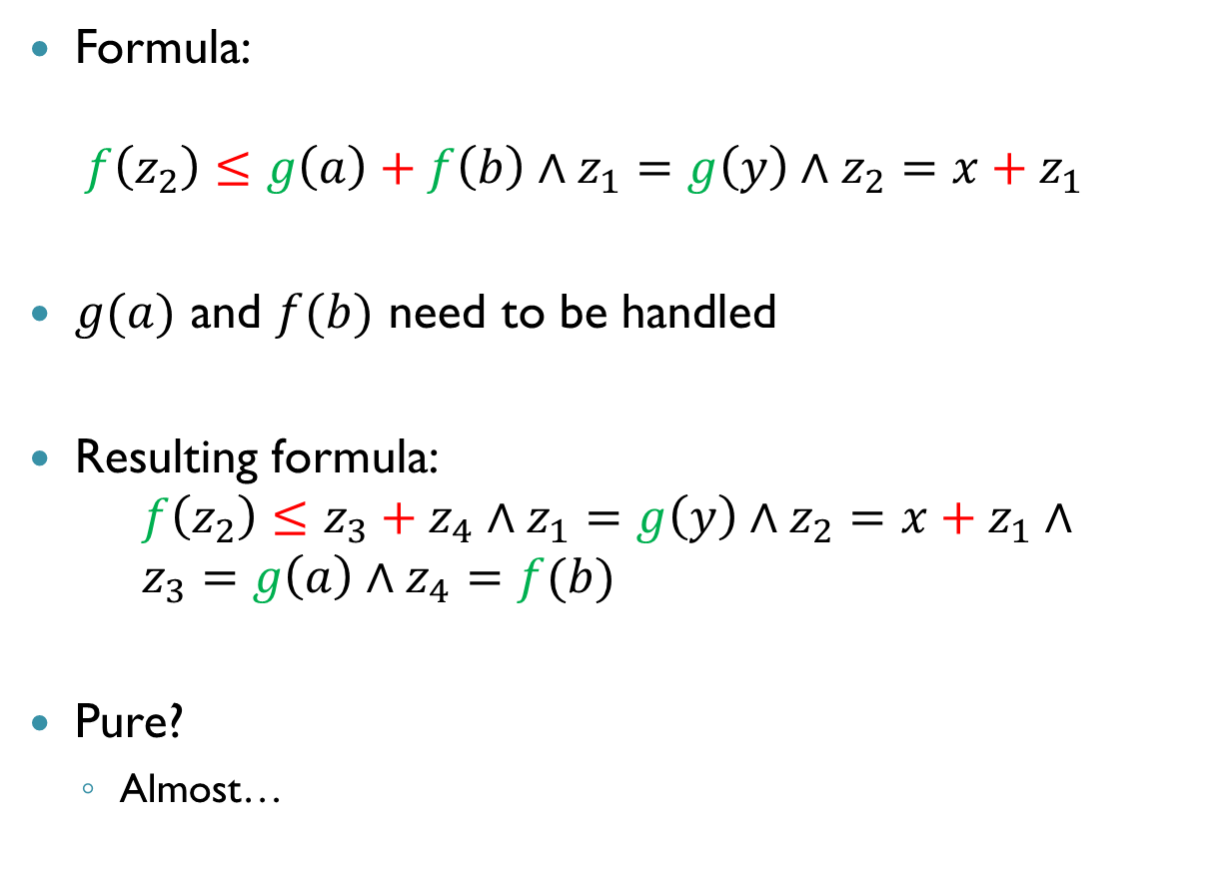
Purificaiton: Example $2$
Formula: $f\left(z_{2}\right)≤g\left(a\right)+f\left(b\right)∧z_{1}=g\left(y\right)∧z_{2}=x+z_{1}$
$g(a)$ and $f(b)$ need to be handled
Resulting formula: $f\left(z_{2}\right)≤z_{3}+z_{4}∧z_{1}=g\left(y\right)∧z_{2}=x+z_{1}∧$ $z_{3}=g\left(a\right)∧z_{4}=f(b)$
Pure?
Almost…

Slide 18

Purificaiton: Example $2$
Formula: $f\left(z_{2}\right)≤z_{3}+z_{4}∧z_{1}=g\left(y\right)∧z_{2}=x+z_{1}∧$ $z_{3}=g\left(a\right)∧z_{4}=f(b)$
Set $z_{5}=f\left(z_{2}\right)$
Finally: $z_{5}≤z_{3}+z_{4}∧z_{1}=g\left(y\right)∧z_{2}=x+z_{1}∧$ $z_{3}=g\left(a\right)∧z_{4}=f\left(b\right)∧z_{5}=f\left(z_{2}\right)$

Slide 19

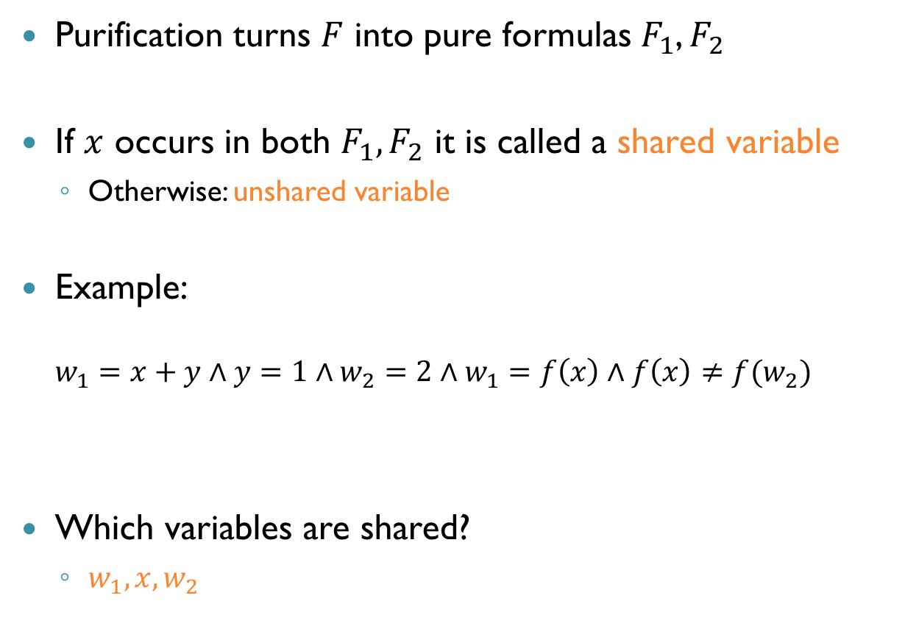

Shared Variables
Purification turns $F$ into pure formulas $F_{1}$, $F_{2}$
If $x$ occurs in both $F_{1},F_{2}$ it is called a shared variable
Otherwise: unshared variable
Example: $w_{1}=x+y∧y=1∧w_{2}=2∧w_{1}=f\left(x\right)∧f\left(x\right)≠f(w_{2})$
Which variables are shared?
$w_{1},x,w_{2}$
$$T_{ℚ}$$
$$T_{UF}$$

Slide 20
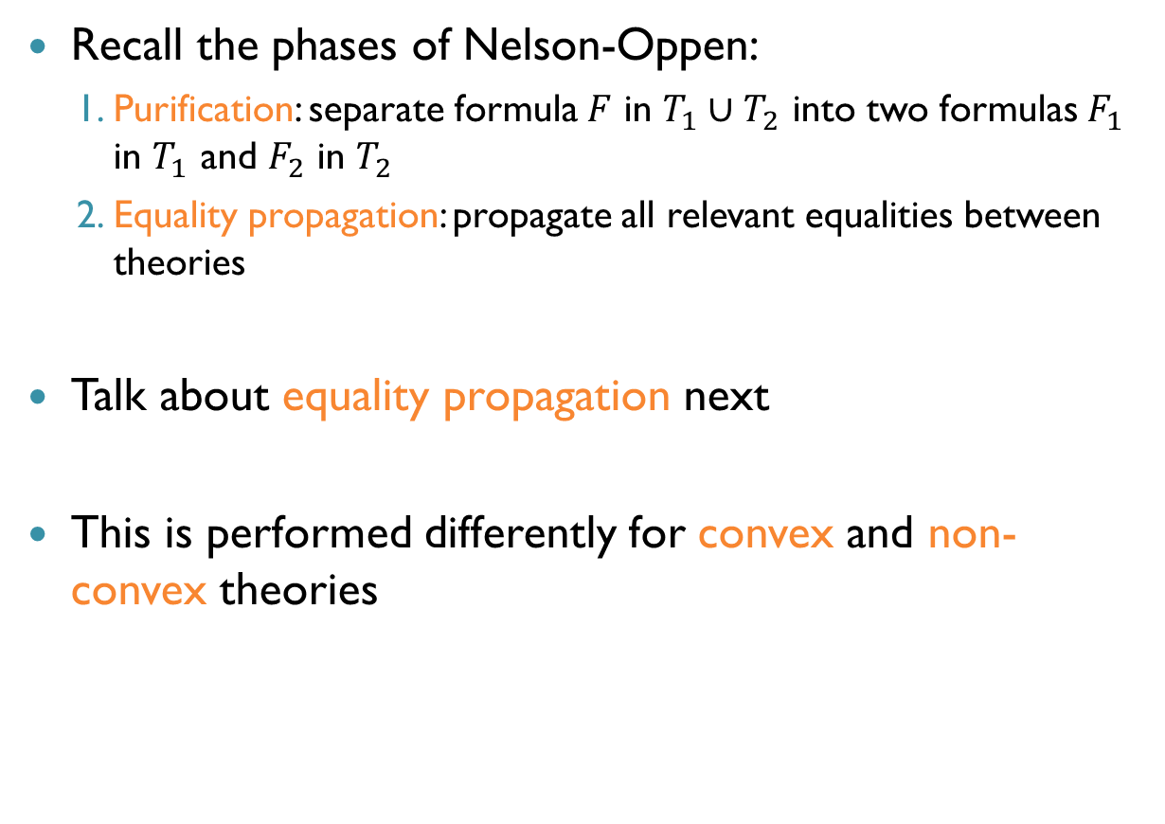
Phase Two of Nelson-Oppen
Recall the phases of Nelson-Oppen:
Purification: separate formula $F$ in $T_{1}∪T_{2}$ into two formulas $F_{1}$ in $T_{1}$ and $F_{2}$ in $T_{2}$
Equality propagation: propagate all relevant equalities between theories
Talk about equality propagation next
This is performed differently for convex and non-convex theories

Slide 21
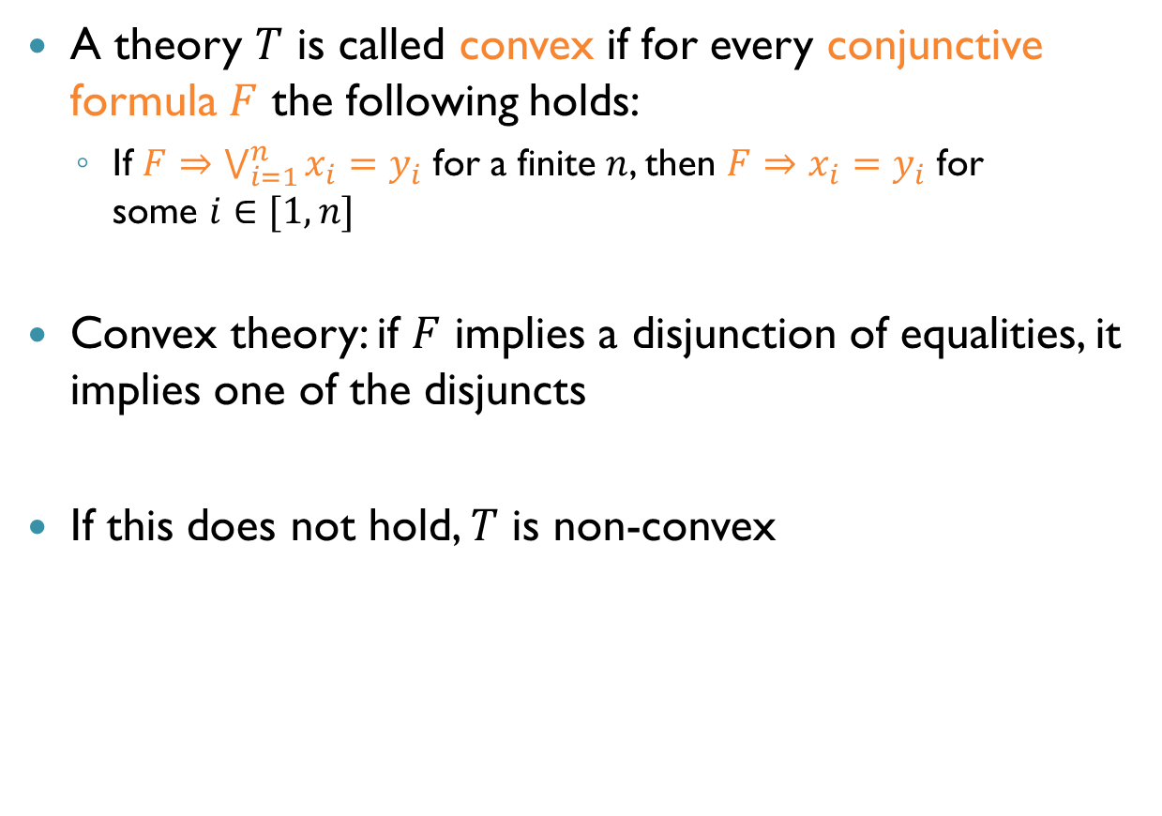
Convex Theories
A theory $T$ is called convex if for every conjunctive formula $F$ the following holds:
If $F⇒\bigvee_{i=1}^{n}{x_{i}=y_{i}}$ for a finite $n$, then $F⇒x_{i}=y_{i}$ for some $i∈[1,n]$
Convex theory: if $F$ implies a disjunction of equalities, it implies one of the disjuncts
If this does not hold, $T$ is non-convex

Slide 22
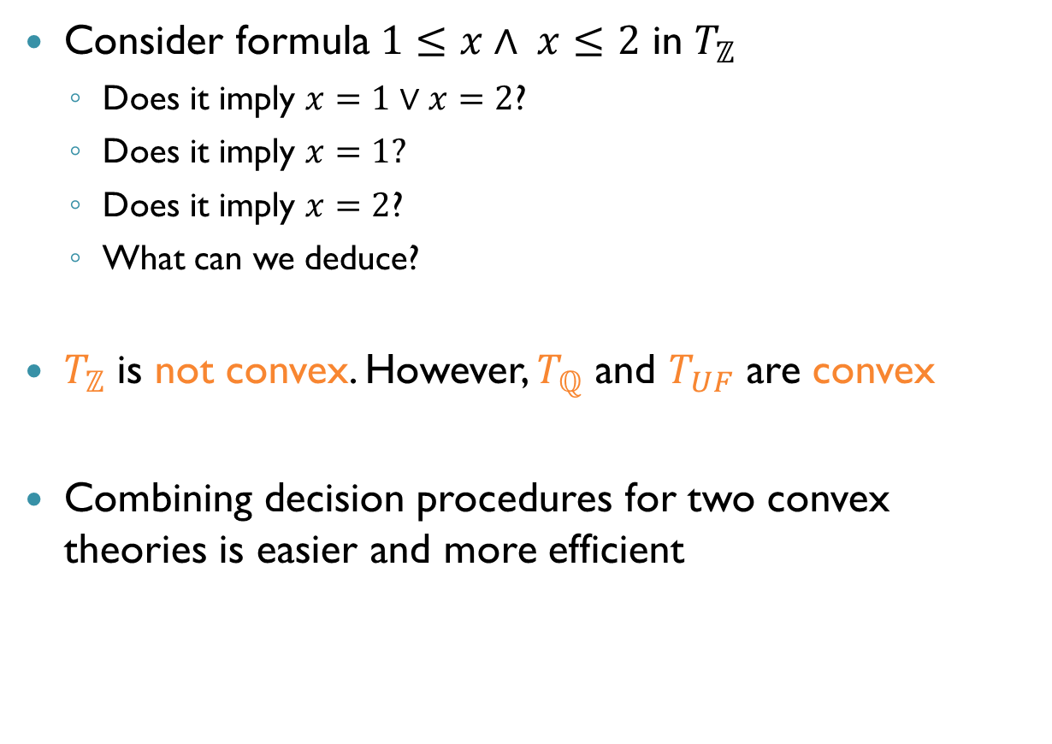
Convex Theories: Examples
Consider formula $1≤x∧ x≤2$ in $T_{ℤ}$
Does it imply $x=1∨x=2$?
Does it imply $x=1?$
Does it imply $x=2$?
What can we deduce?
$T_{ℤ}$ is not convex. However, $T_{ℚ}$ and $T_{UF}$ are convex
Combining decision procedures for two convex theories is easier and more efficient

Slide 23
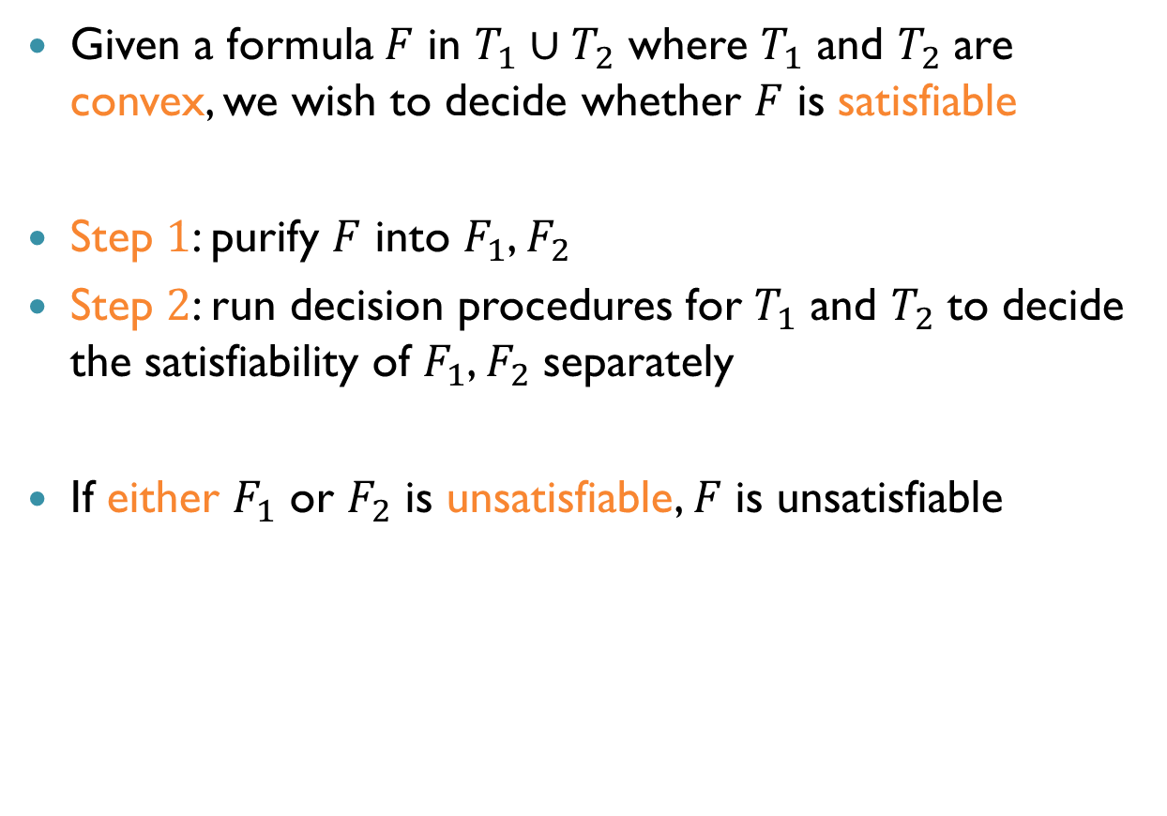
Nelson-Oppen for Convex Theories
Given a formula $F$ in $T_{1}∪T_{2}$ where $T_{1}$ and $T_{2}$ are convex, we wish to decide whether $F$ is satisfiable
Step $1$: purify $F$ into $F_{1}$, $F_{2}$
Step $2$: run decision procedures for $T_{1}$ and $T_{2}$ to decide the satisfiability of $F_{1}$, $F_{2}$ separately
If either $F_{1}$ or $F_{2}$ is unsatisfiable, $F$ is unsatisfiable

Slide 24

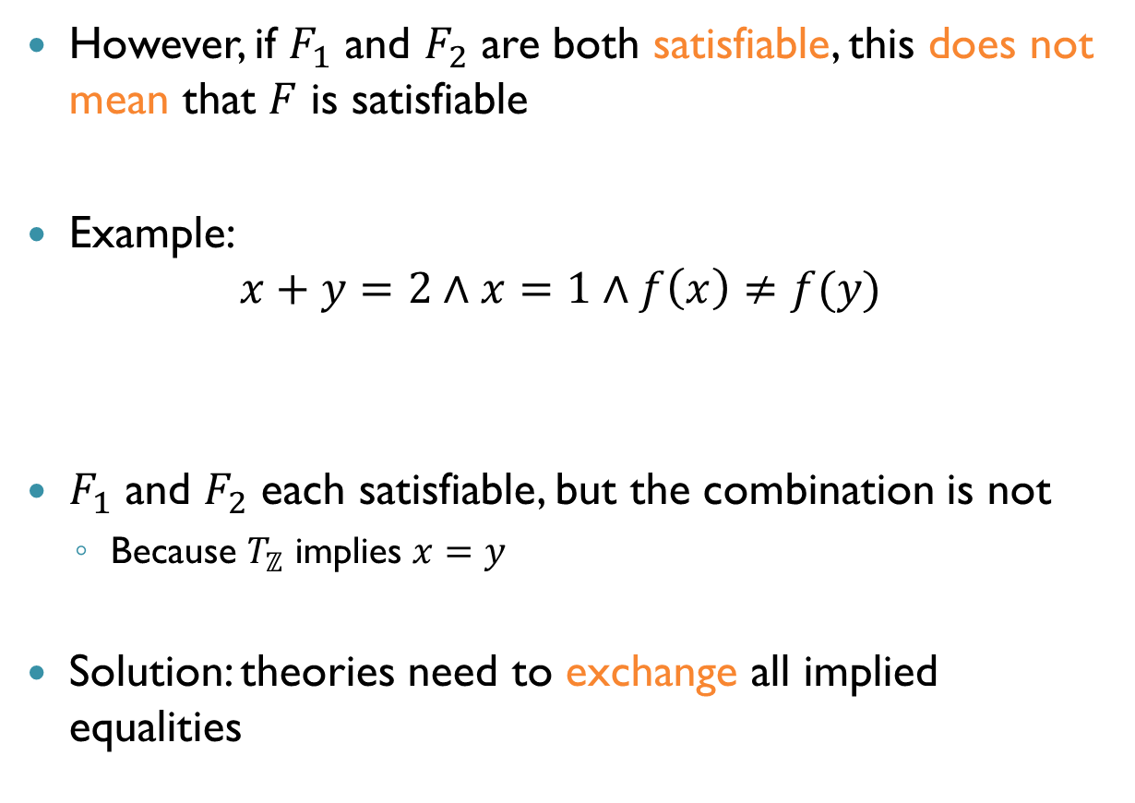

Nelson-Oppen for Convex Theories (cnt’d)
However, if $F_{1}$ and $F_{2}$ are both satisfiable, this does not mean that $F$ is satisfiable
Example: $x+y=2∧x=1∧f\left(x\right)≠f(y)$
$F_{1}$ and $F_{2}$ each satisfiable, but the combination is not
Because $T_{ℤ}$ implies $x=y$
Solution: theories need to exchange all implied equalities
$$T_{ℤ}$$
$$T_{UF}$$

Slide 25
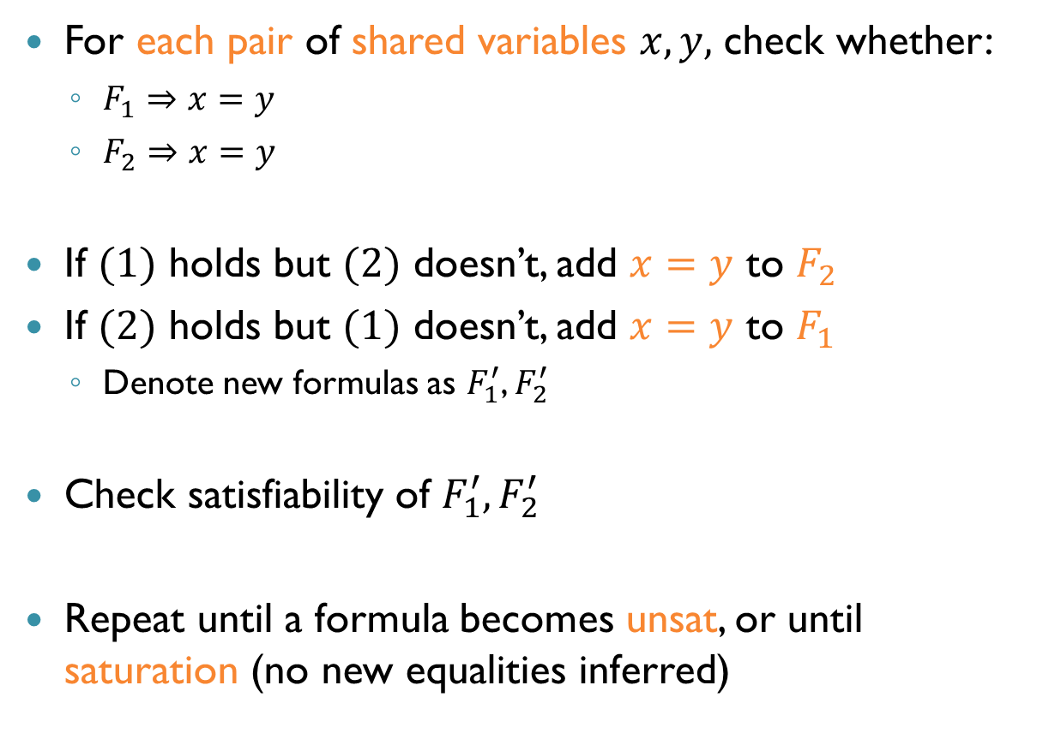
Nelson-Oppen for Convex Theories (cnt’d)
For each pair of shared variables $x,y,$ check whether:
$F_{1}⇒x=y$
$F_{2}⇒x=y$
If $(1)$ holds but $(2)$ doesn’t, add $x=y$ to $F_{2}$
If $(2)$ holds but $(1)$ doesn’t, add $x=y$ to $F_{1}$
Denote new formulas as $F_{1}^{′}$, $F_{2}^{′}$
Check satisfiability of $F_{1}^{′},F_{2}^{′}$
Repeat until a formula becomes unsat, or until saturation (no new equalities inferred)

Slide 26
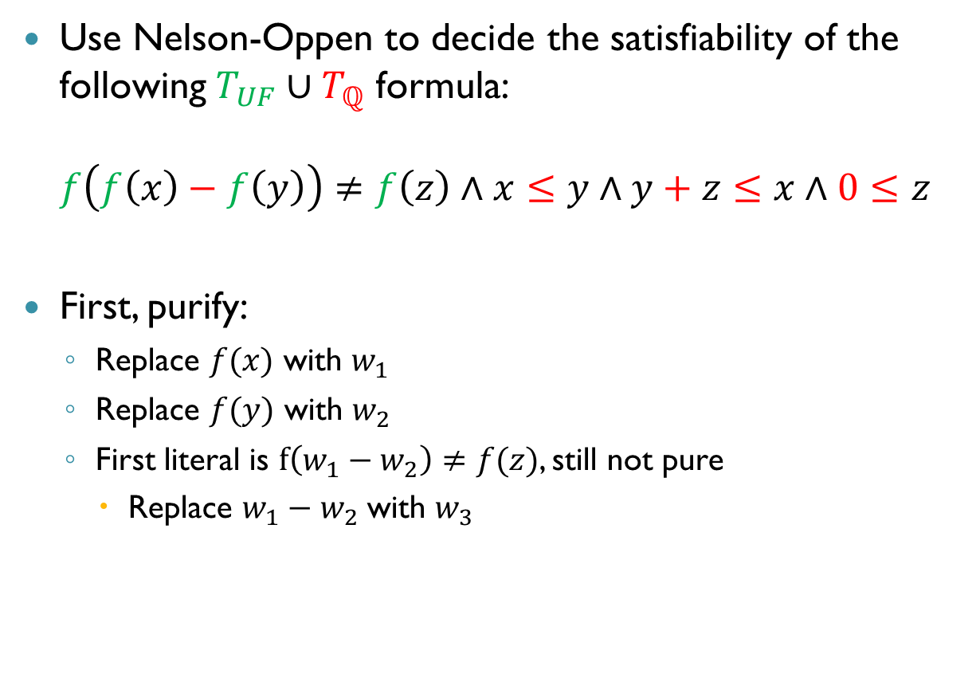
Example
Use Nelson-Oppen to decide the satisfiability of the following $T_{UF}∪T_{ℚ}$ formula: $f\left(f\left(x\right)−f\left(y\right)\right)≠f\left(z\right)∧x≤y∧y+z≤x∧0≤z$
First, purify:
Replace $f(x)$ with $w_{1}$
Replace $f(y)$ with $w_{2}$
First literal is $f\left(w_{1}−w_{2}\right)≠f(z)$, still not pure
Replace $w_{1}−w_{2}$ with $w_{3}$

Slide 27
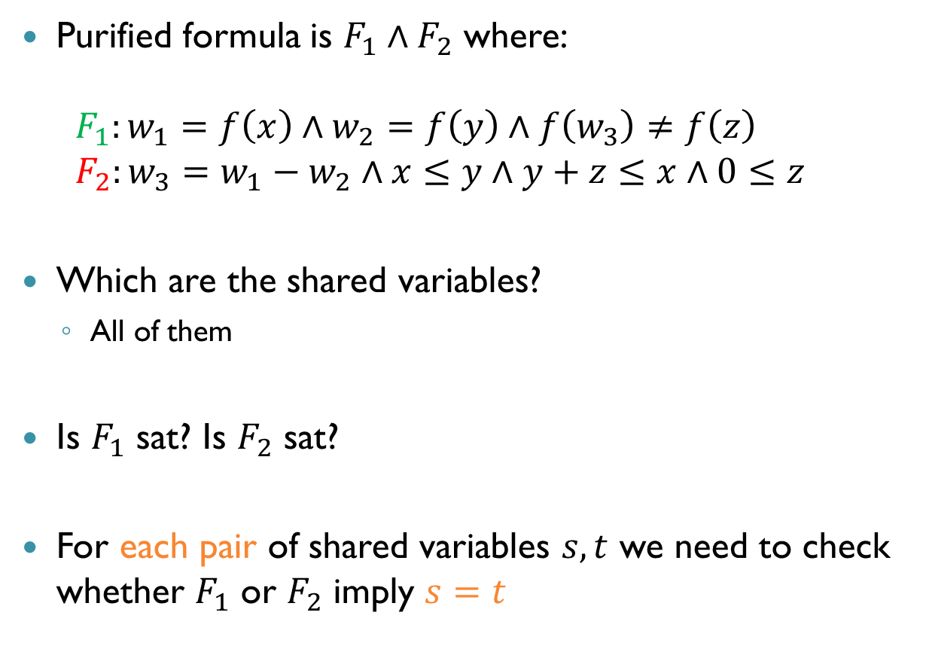
Example (cnt’d)
Purified formula is $F_{1}∧F_{2}$ where: $F_{1}:w_{1}=f\left(x\right)∧w_{2}=f\left(y\right)∧f\left(w_{3}\right)≠f\left(z\right)$ $F_{2}:w_{3}=w_{1}−w_{2}∧x≤y∧y+z≤x∧0≤z$
Which are the shared variables?
All of them
Is $F_{1}$ sat? Is $F_{2}$ sat?
For each pair of shared variables $s,t$ we need to check whether $F_{1}$ or $F_{2}$ imply $s=t$

Slide 28
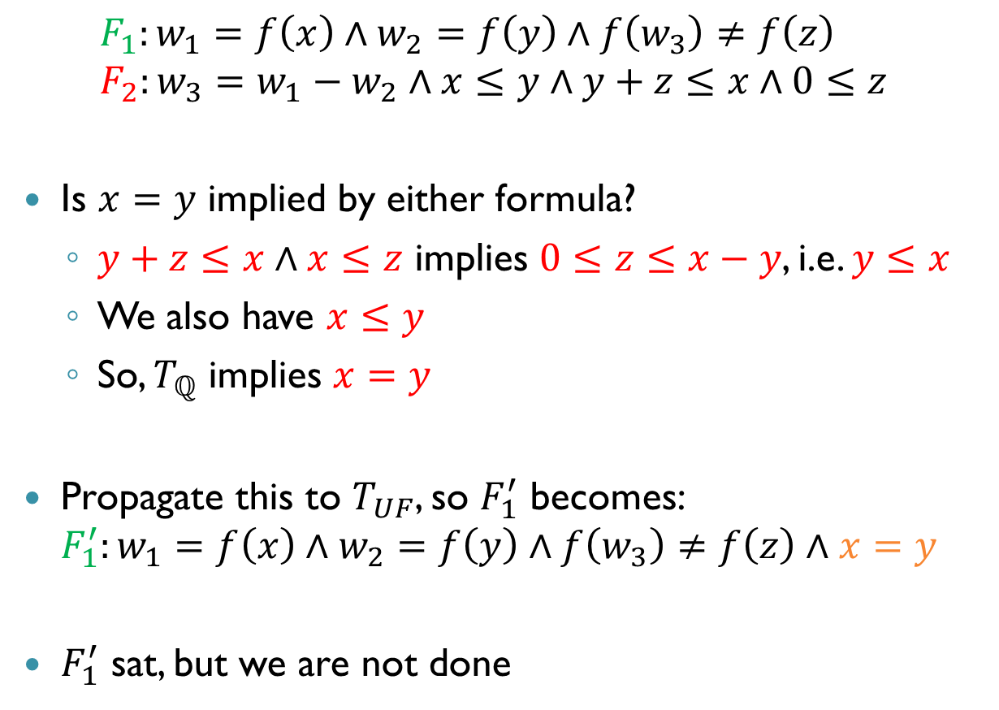
Example (cnt’d)
$$F_{1}:w_{1}=f\left(x\right)∧w_{2}=f\left(y\right)∧f\left(w_{3}\right)≠f\left(z\right) \\ F_{2}:w_{3}=w_{1}−w_{2}∧x≤y∧y+z≤x∧0≤z$$
Is $x=y$ implied by either formula?
$y+z≤x∧x≤z$ implies $0≤z≤x−y$, i.e. $y≤x$
We also have $x≤y$
So, $T_{ℚ}$ implies $x=y$
Propagate this to $T_{UF}$, so $F_{1}^{′}$ becomes: $F_{1}^{′}:w_{1}=f\left(x\right)∧w_{2}=f\left(y\right)∧f\left(w_{3}\right)≠f\left(z\right)∧x=y$
$F_{1}^{′}$ sat, but we are not done

Slide 29
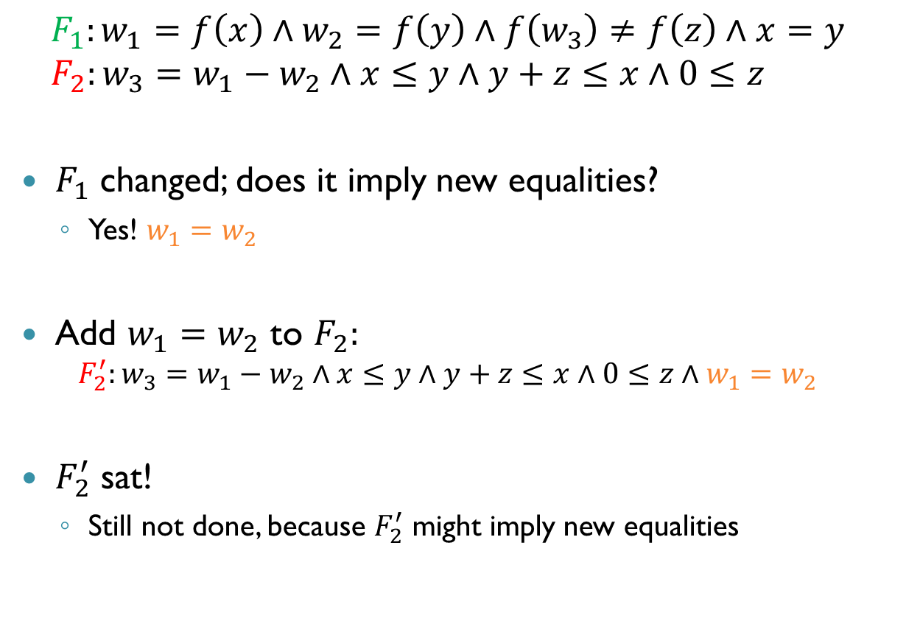
Example (cnt’d)
$$F_{1}:w_{1}=f\left(x\right)∧w_{2}=f\left(y\right)∧f\left(w_{3}\right)≠f\left(z\right)∧x=y \\ F_{2}:w_{3}=w_{1}−w_{2}∧x≤y∧y+z≤x∧0≤z$$
$F_{1}$ changed; does it imply new equalities?
Yes! $w_{1}=w_{2}$
Add $w_{1}=w_{2}$ to $F_{2}:$ $F_{2}^{′}:w_{3}=w_{1}−w_{2}∧x≤y∧y+z≤x∧0≤z∧w_{1}=w_{2}$
$F_{2}^{′}$ sat!
Still not done, because $F_{2}^{′}$ might imply new equalities

Slide 30
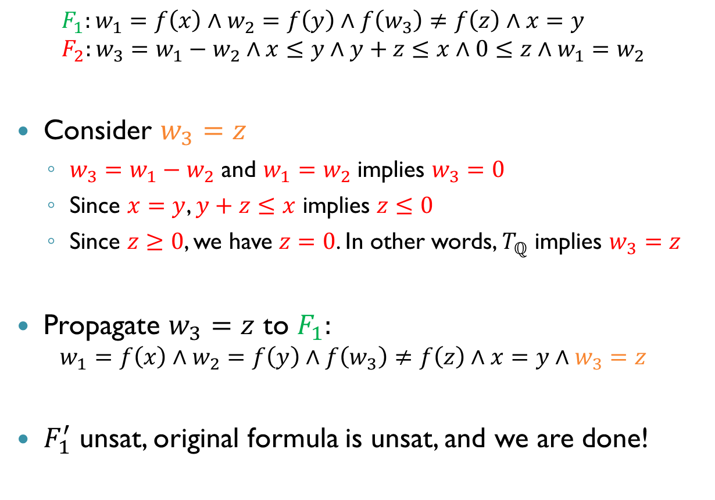
Example (cnt’d)
$$F_{1}:w_{1}=f\left(x\right)∧w_{2}=f\left(y\right)∧f\left(w_{3}\right)≠f\left(z\right)∧x=y \\ F_{2}:w_{3}=w_{1}−w_{2}∧x≤y∧y+z≤x∧0≤z∧w_{1}=w_{2}$$
Consider $w_{3}=z$
$w_{3}=w_{1}−w_{2}$ and $w_{1}=w_{2}$ implies $w_{3}=0$
Since $x=y$, $y+z≤x$ implies $z≤0$
Since $z≥0$, we have $z=0$. In other words, $T_{ℚ}$ implies $w_{3}=z$
Propagate $w_{3}=z$ to $F_{1}:$ $w_{1}=f\left(x\right)∧w_{2}=f\left(y\right)∧f\left(w_{3}\right)≠f\left(z\right)∧x=y∧w_{3}=z$
$F_{1}^{′}$ unsat, original formula is unsat, and we are done!

Slide 31
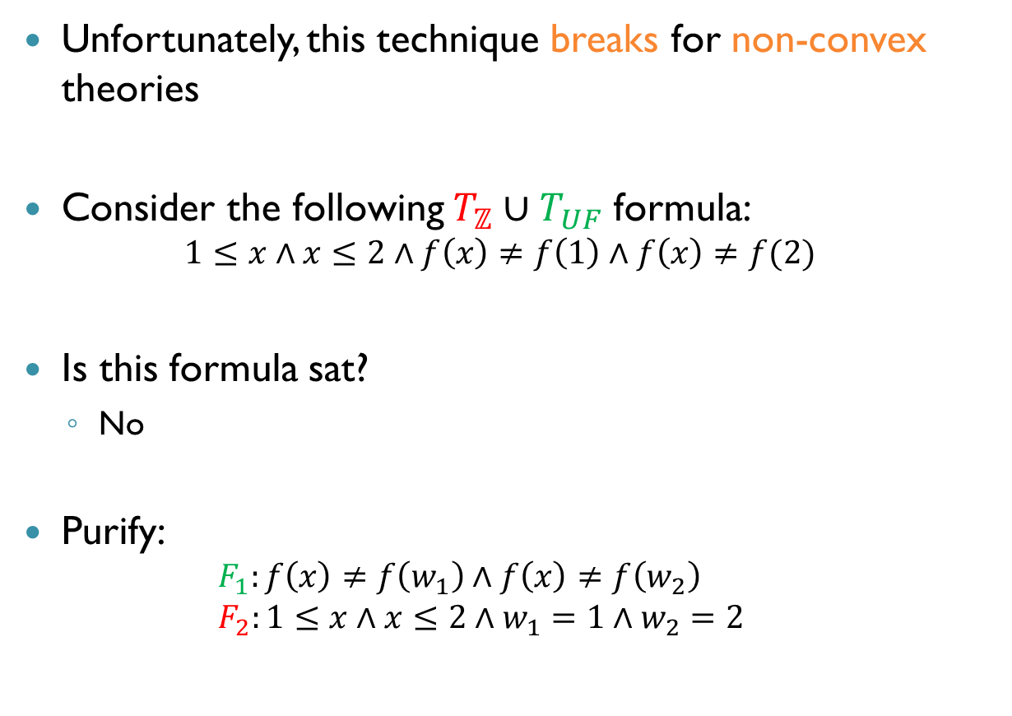
Non-Convex Theories
Unfortunately, this technique breaks for non-convex theories
Consider the following $T_{ℤ}∪T_{UF}$ formula: $1≤x∧x≤2∧f\left(x\right)≠f\left(1\right)∧f\left(x\right)≠f(2)$
Is this formula sat?
No
Purify: $F_{1}:f\left(x\right)≠f\left(w_{1}\right)∧f\left(x\right)≠f\left(w_{2}\right)$ $F_{2}:1≤x∧x≤2∧w_{1}=1∧w_{2}=2$

Slide 32
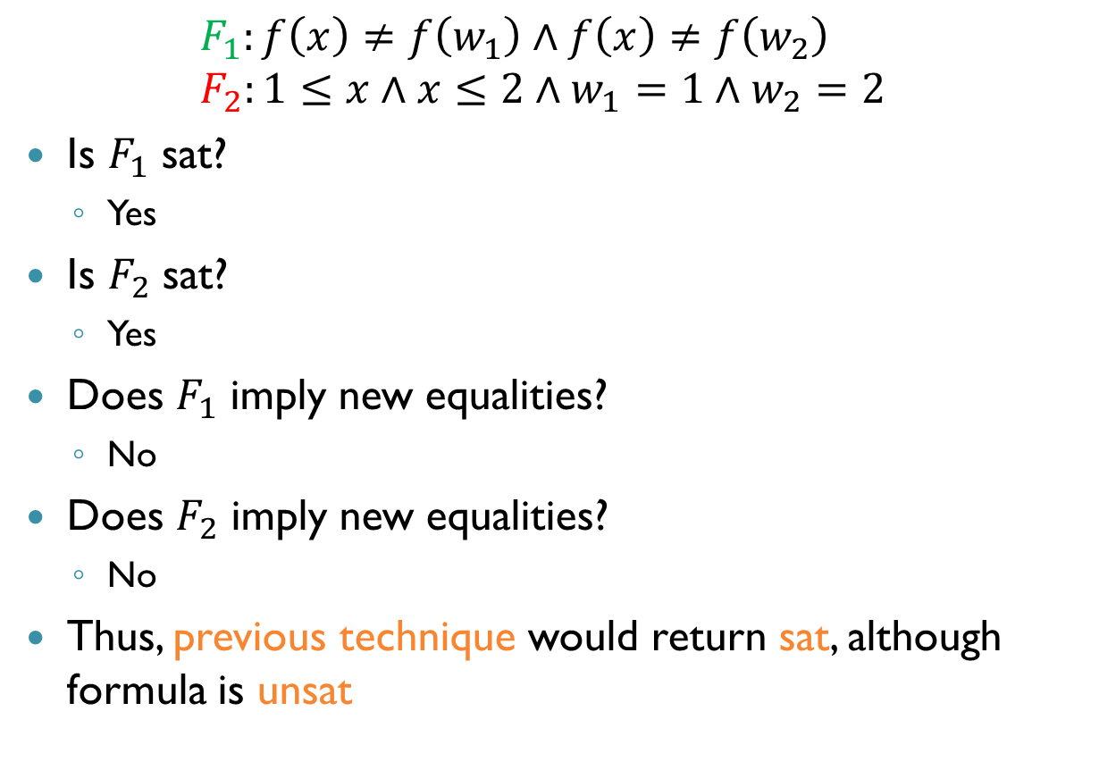
Non-Convex Theories (cnt’d)
$$F_{1}:f\left(x\right)≠f\left(w_{1}\right)∧f\left(x\right)≠f\left(w_{2}\right) \\ F_{2}:1≤x∧x≤2∧w_{1}=1∧w_{2}=2$$
Is $F_{1}$ sat?
Yes
Is $F_{2}$ sat?
Yes
Does $F_{1}$ imply new equalities?
No
Does $F_{2}$ imply new equalities?
No
Thus, previous technique would return sat, although formula is unsat

Slide 33
Nelson-Oppen for Non-Convex Theories
Problem: a theory might imply a disjunction of equalities, but none of the individual disjuncts
So we also have to propagate disjunctions of equalities between theories
But how can you propagate disjunctions, when formulas are conjunctions?

Slide 34
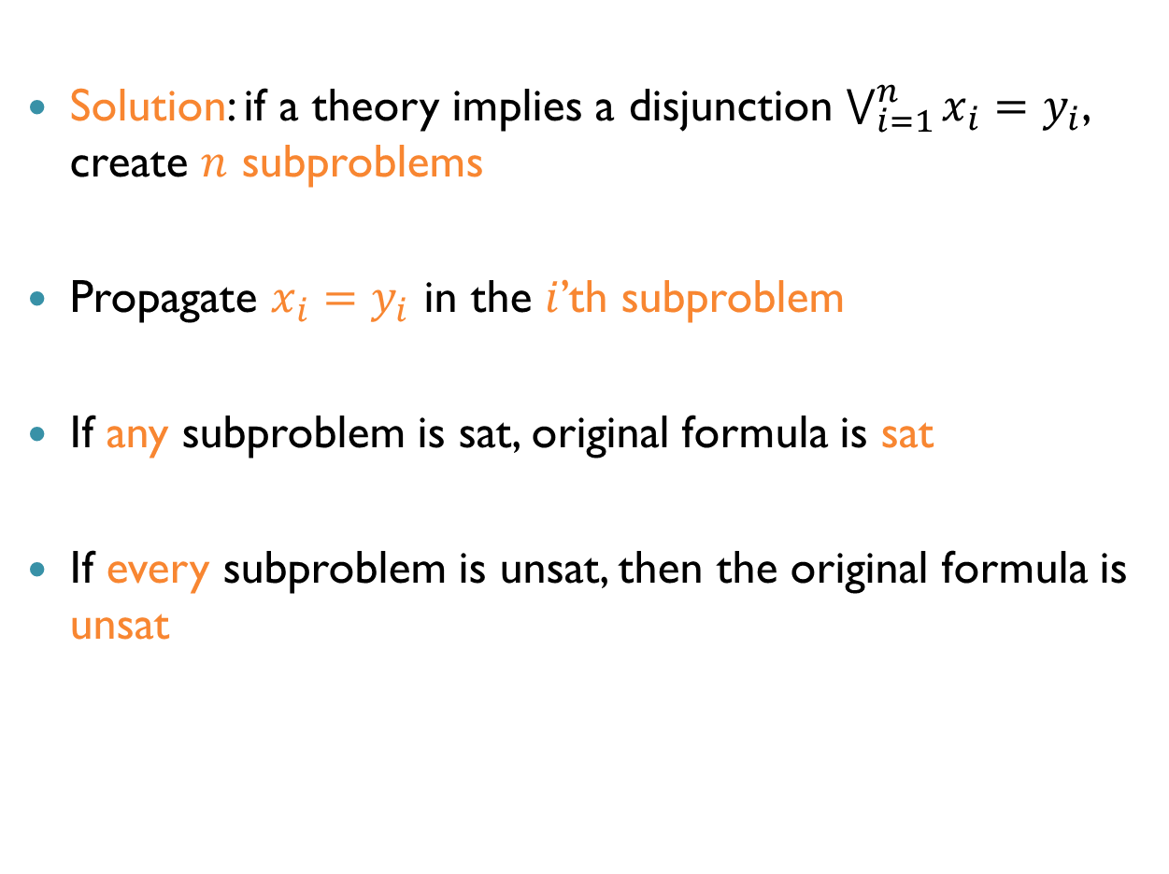
Nelson-Oppen for Non-Convex Theories (cnt’d)
Solution: if a theory implies a disjunction $\bigvee_{i=1}^{n}{x_{i}=y_{i}}$, create $n$ subproblems
Propagate $x_{i}=y_{i}$ in the $i$’th subproblem
If any subproblem is sat, original formula is sat
If every subproblem is unsat, then the original formula is unsat

Slide 35
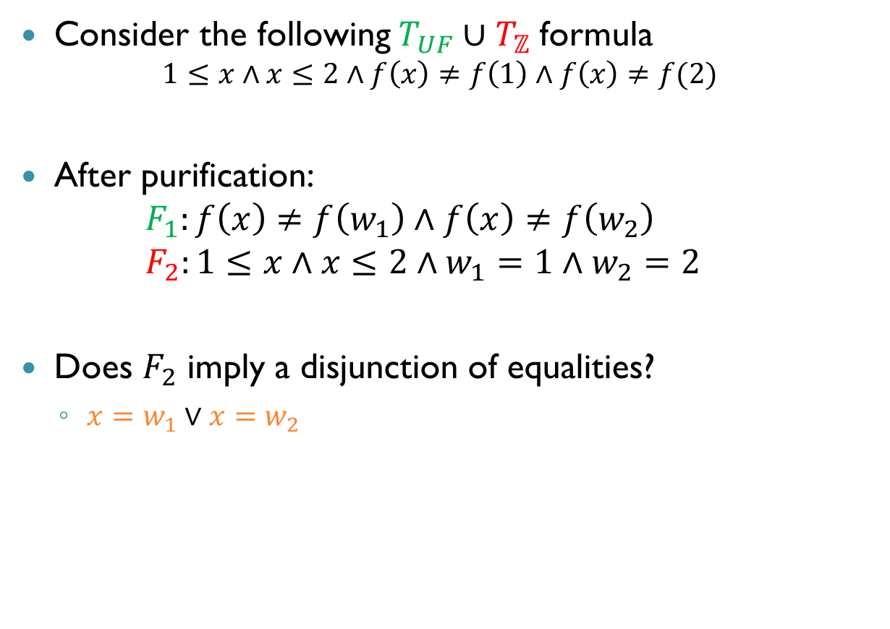
Example
Consider the following $T_{UF}∪T_{ℤ}$ formula $1≤x∧x≤2∧f\left(x\right)≠f\left(1\right)∧f\left(x\right)≠f(2)$
After purification: $F_{1}:f\left(x\right)≠f\left(w_{1}\right)∧f\left(x\right)≠f\left(w_{2}\right)$ $F_{2}:1≤x∧x≤2∧w_{1}=1∧w_{2}=2$
Does $F_{2}$ imply a disjunction of equalities?
$x=w_{1}∨x=w_{2}$

Slide 36

Example (cnt’d)
First subproblem: $F_{1}:f\left(x\right)≠f\left(w_{1}\right)∧f\left(x\right)≠f\left(w_{2}\right)∧x=w_{1}$ $F_{2}:1≤x∧x≤2∧w_{1}=1∧w_{2}=2$
Is this satisfiable?
No

Slide 37
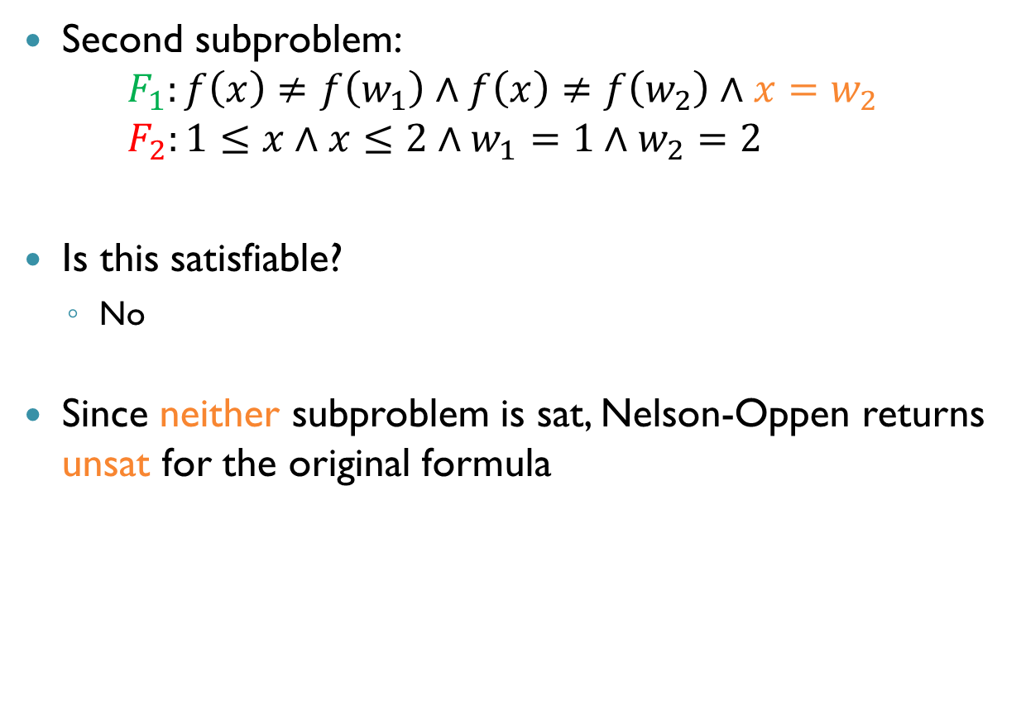
Example (cnt’d)
Second subproblem: $F_{1}:f\left(x\right)≠f\left(w_{1}\right)∧f\left(x\right)≠f\left(w_{2}\right)∧x=w_{2}$ $F_{2}:1≤x∧x≤2∧w_{1}=1∧w_{2}=2$
Is this satisfiable?
No
Since neither subproblem is sat, Nelson-Oppen returns unsat for the original formula

Slide 38
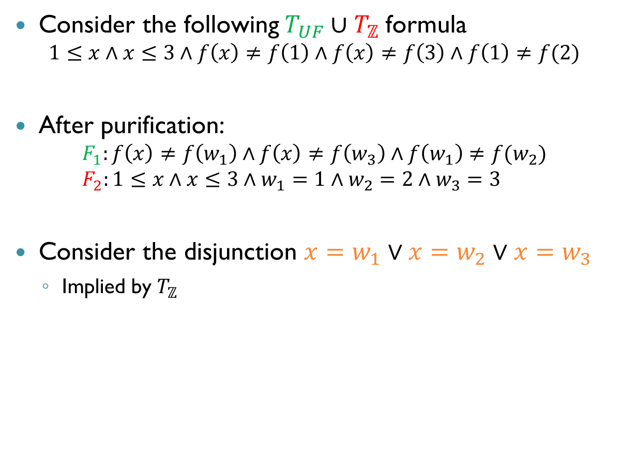
Another Example
Consider the following $T_{UF}∪T_{ℤ}$ formula $1≤x∧x≤3∧f\left(x\right)≠f\left(1\right)∧f\left(x\right)≠f\left(3\right)∧f\left(1\right)≠f(2)$
After purification: $F_{1}:f\left(x\right)≠f\left(w_{1}\right)∧f\left(x\right)≠f\left(w_{3}\right)∧f\left(w_{1}\right)≠f(w_{2})$ $F_{2}:1≤x∧x≤3∧w_{1}=1∧w_{2}=2∧w_{3}=3$
Consider the disjunction $x=w_{1}∨x=w_{2}∨x=w_{3}$
Implied by $T_{ℤ}$

Slide 39
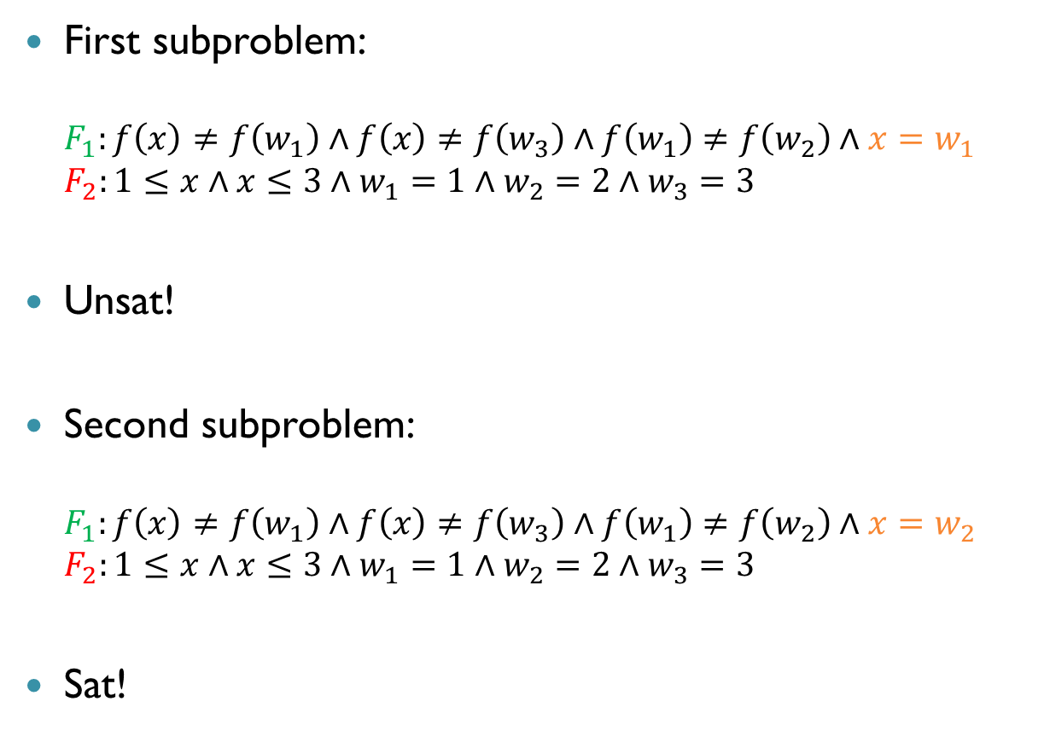
Another Example (cnt’d)
First subproblem: $F_{1}:f\left(x\right)≠f\left(w_{1}\right)∧f\left(x\right)≠f\left(w_{3}\right)∧f\left(w_{1}\right)≠f\left(w_{2}\right)∧x=w_{1}$ $F_{2}:1≤x∧x≤3∧w_{1}=1∧w_{2}=2∧w_{3}=3$
Unsat!
Second subproblem: $F_{1}:f\left(x\right)≠f\left(w_{1}\right)∧f\left(x\right)≠f\left(w_{3}\right)∧f\left(w_{1}\right)≠f\left(w_{2}\right)∧x=w_{2}$ $F_{2}:1≤x∧x≤3∧w_{1}=1∧w_{2}=2∧w_{3}=3$
Sat!

Slide 40
Another Example (cnt’d)
No new equalities or disjunctions of equalities are implied, so we are done
No need to check the third subproblem
The original formula is satisfiable

Slide 41
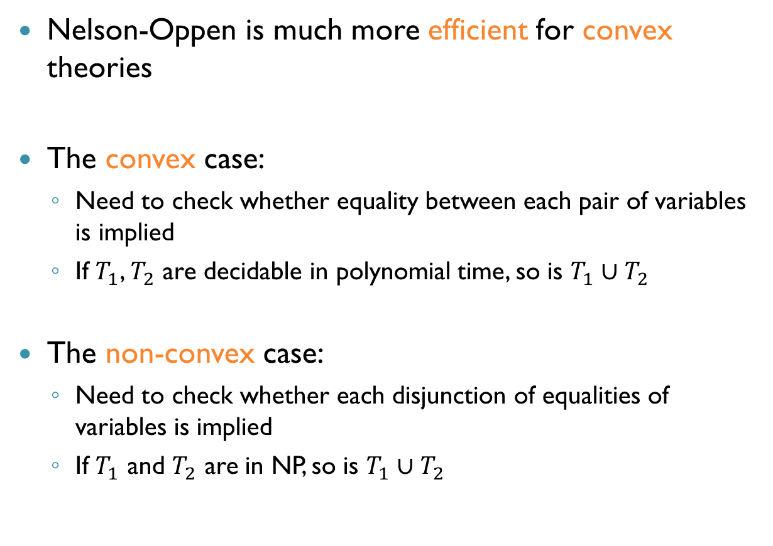
Summary: Convex vs. Non-Convex
Nelson-Oppen is much more efficient for convex theories
The convex case:
Need to check whether equality between each pair of variables is implied
If $T_{1}$, $T_{2}$ are decidable in polynomial time, so is $T_{1}∪T_{2}$
The non-convex case:
Need to check whether each disjunction of equalities of variables is implied
If $T_{1}$ and $T_{2}$ are in NP, so is $T_{1}∪T_{2}$

Slide 42
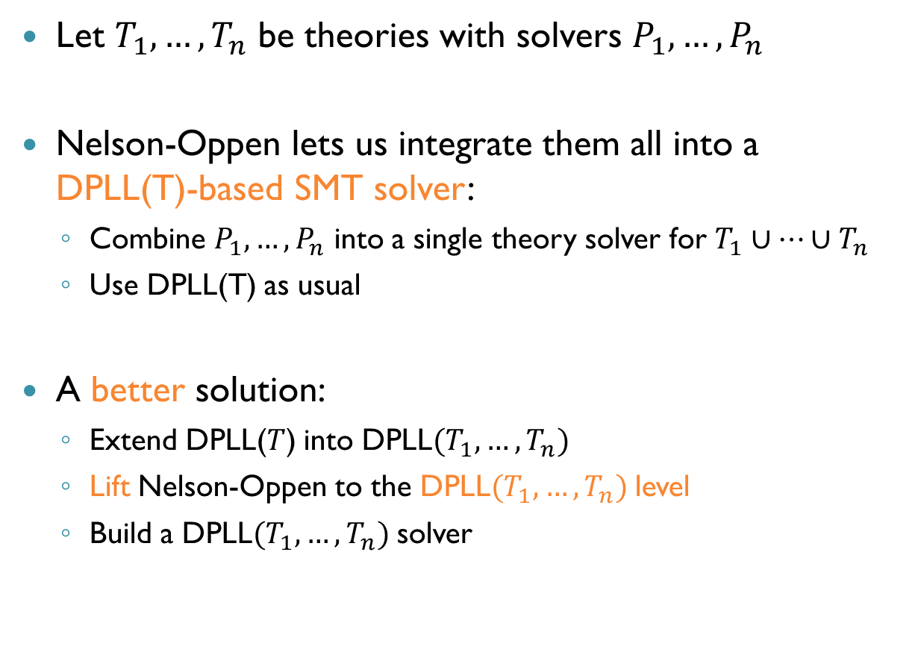
SMT Solving with Multiple Theories
Let $T_{1},…, T_{n}$ be theories with solvers $P_{1},…, P_{n}$
Nelson-Oppen lets us integrate them all into a DPLL(T)-based SMT solver:
Combine $P_{1},…, P_{n}$ into a single theory solver for $T_{1}∪…∪T_{n}$
Use DPLL(T) as usual
A better solution:
Extend DPLL($T$) into DPLL$(T_{1},…, T_{n})$
Lift Nelson-Oppen to the DPLL$(T_{1},…, T_{n})$ level
Build a DPLL$(T_{1},…, T_{n})$ solver

Slide 43
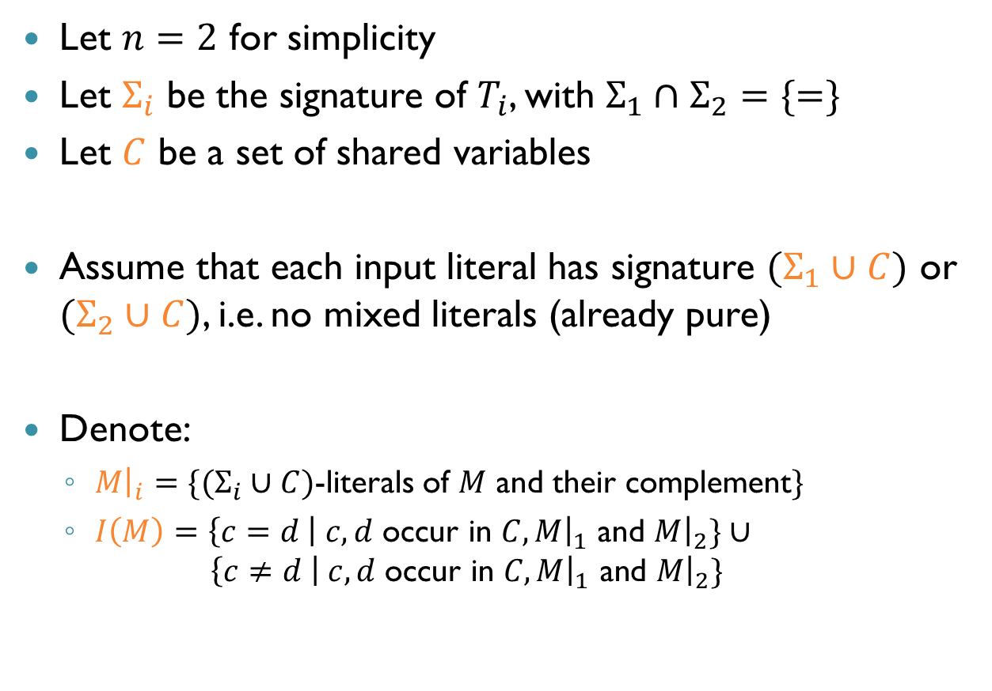

Modeling DPLL($T_{1},…T_{n}$)
Let $n=2$ for simplicity
Let $Σ_{i}$ be the signature of $T_{i}$, with $Σ_{1}∩Σ_{2}=\{=\}$
Let $C$ be a set of shared variables
Assume that each input literal has signature $(Σ_{1}∪C)$ or $(Σ_{2}∪C)$, i.e. no mixed literals (already pure)
Denote:
$M{\left.​\right|}_{i}=\{(Σ_{i}∪C)$-literals of $M$ and their complement$\}$
$I\left(M\right)=\left\{c=d \right| c,d$ occur in $C,M{\left.​\right|}_{1}$ and $M{\left.​\right|}_{2}\}∪$ $\left\{c≠d \right| c,d \text{occur} \text{in} C,M{\left.​\right|}_{1} \text{and} M{\left.​\right|}_{2}\}$

Slide 44
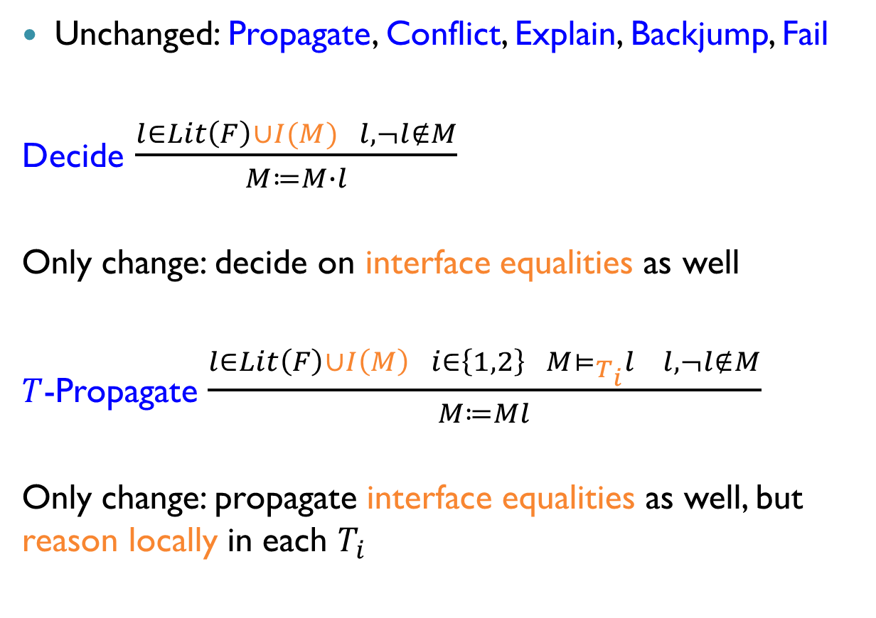
Abstract DPLL Modulo Multiple Theories
Unchanged: Propagate, Conflict, Explain, Backjump, Fail
Decide $\frac{l∈Lit\left(F\right)∪I(M) l,¬l∉M}{M≔M∙l}$
Only change: decide on interface equalities as well
$T$-Propagate $\frac{l∈Lit\left(F\right)∪I\left(M\right) i∈\left\{1,2\right\} M⊨_{T_{i}}l l,¬l∉M}{M≔Ml}$
Only change: propagate interface equalities as well, but reason locally in each $T_{i}$

Slide 45
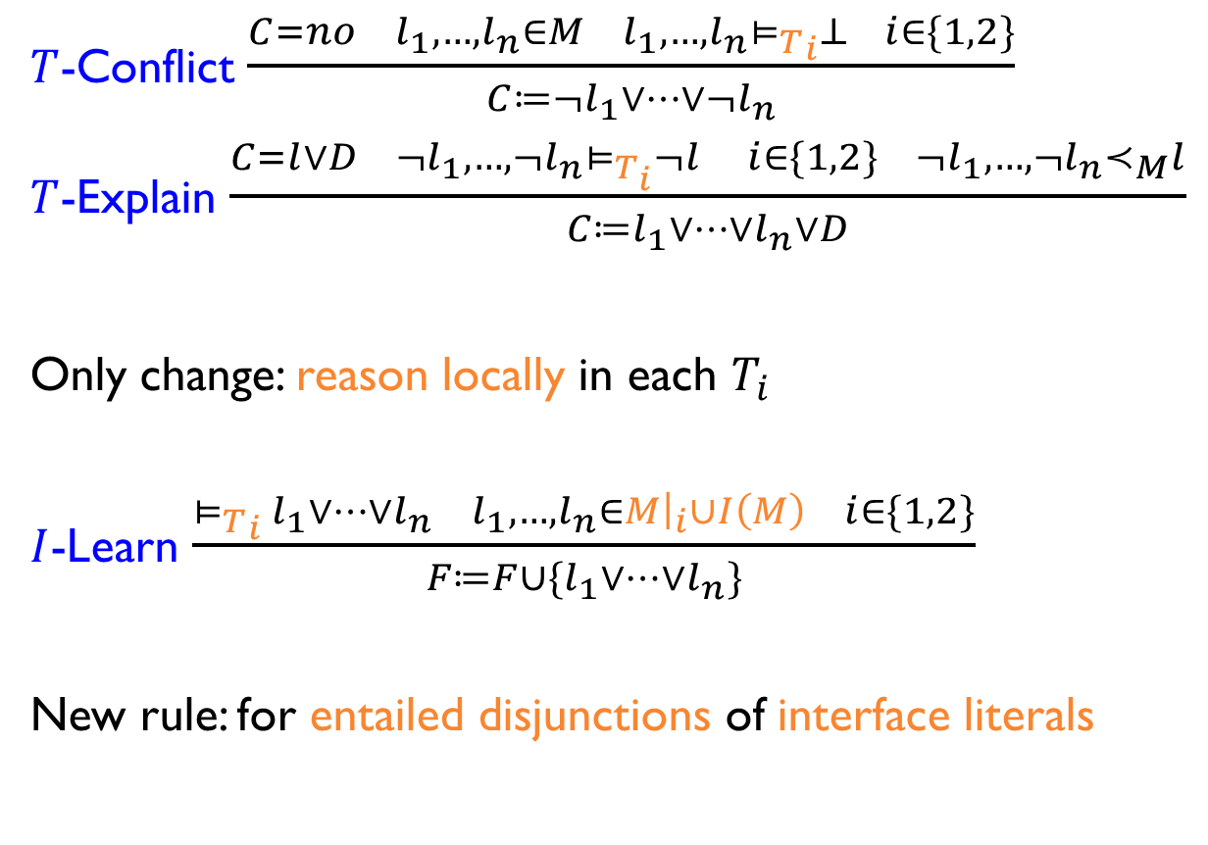
Abstract DPLL Modulo Multiple Theories (cnt’d)
$T$-Conflict $\frac{C=no l_{1},…, l_{n}∈M l_{1},…, l_{n}{⊨_{T}}_{i}⊥ i∈\{1,2\}}{C≔¬l_{1}∨…∨¬l_{n}}$
$T$-Explain $\frac{C=l∨D ¬l_{1},…,¬l_{n}⊨_{T_{i}}¬l i∈\{1,2\} ¬l_{1},…, ¬l_{n}≺_{M}l}{C≔l_{1}∨…∨l_{n}∨D}$
Only change: reason locally in each $T_{i}$
$I$-Learn $\frac{{⊨_{T}}_{i} l_{1}∨…∨l_{n} l_{1},…,l_{n}∈M{\left.​\right|}_{i}∪I\left(M\right) i∈\{1,2\}}{F≔F∪\{l_{1}∨…∨l_{n}\}}$
New rule: for entailed disjunctions of interface literals

Slide 46


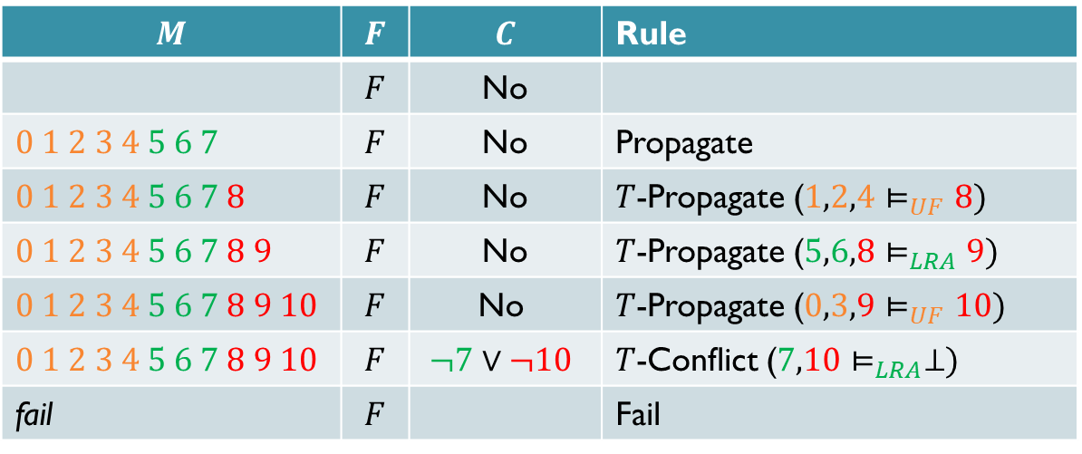


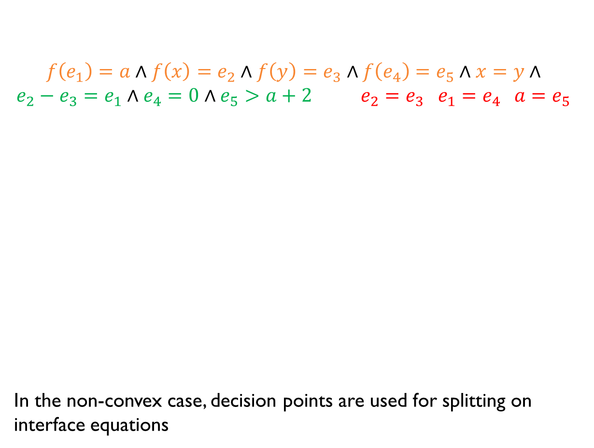








Example (Convex)
$$f\left(e_{1}\right)=a∧f\left(x\right)=e_{2}∧f\left(y\right)=e_{3}∧f\left(e_{4}\right)=e_{5}∧x=y∧ \\ e_{2}−e_{3}=e_{1}∧e_{4}=0∧e_{5}>a+2 e_{2}=e_{3} e_{1}=e_{4} a=e_{5}$$
In the non-convex case, decision points are used for splitting on interface equations
$$x_{0}$$
$$x_{1}$$
$$x_{2}$$
$$x_{3}$$
$$x_{4}$$
$$F:$$
$$x_{5}$$
$$x_{6}$$
$$x_{7}$$
$$x_{8}$$
$$x_{9}$$
$$x_{10}$$
$$M$$ | $$F$$ | $$C$$ | Rule
 | $$F$$ | No
$$0 1 2 3 4 5 6 7$$ | $$F$$ | No | Propagate
$$0 1 2 3 4 5 6 7 8$$ | $$F$$ | No | $T$-Propagate ($1,2,4⊨_{UF}8)$
$$0 1 2 3 4 5 6 7 8 9$$ | $$F$$ | No | $T$-Propagate ($5,6,8⊨_{LRA}9)$
$$0 1 2 3 4 5 6 7 8 9 10$$ | $$F$$ | $$\text{No}$$ | $T$-Propagate ($0,3,9⊨_{UF}10)$
$$0 1 2 3 4 5 6 7 8 9 10$$ | $$F$$ | $$¬7∨¬10$$ | $T$-Conflict ($7,10⊨_{LRA}⊥)$
fail | $$F$$ |  | Fail

Slide 47
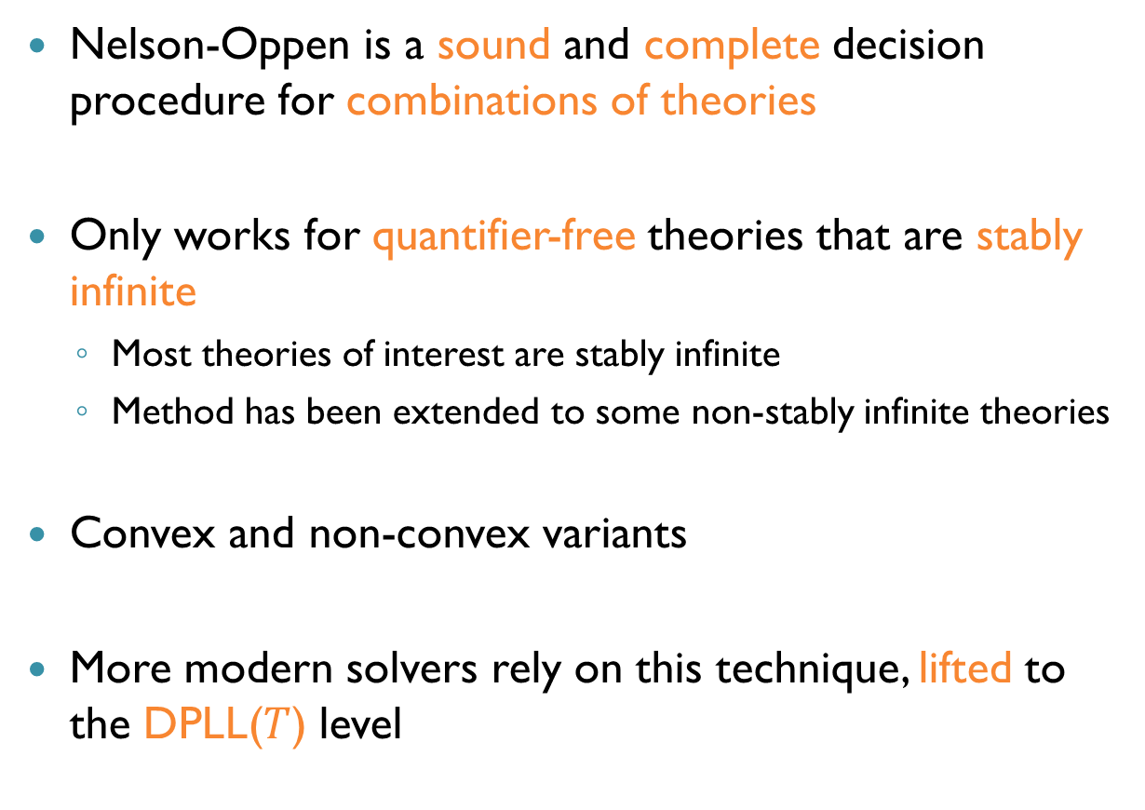
Summary
Nelson-Oppen is a sound and complete decision procedure for combinations of theories
Only works for quantifier-free theories that are stably infinite
Most theories of interest are stably infinite
Method has been extended to some non-stably infinite theories
Convex and non-convex variants
More modern solvers rely on this technique, lifted to the DPLL($T$) level

